Slide 1
F1 Championship Standings Database
CS 1103 Final Project
By Zachary Bourgeois

Slide 2
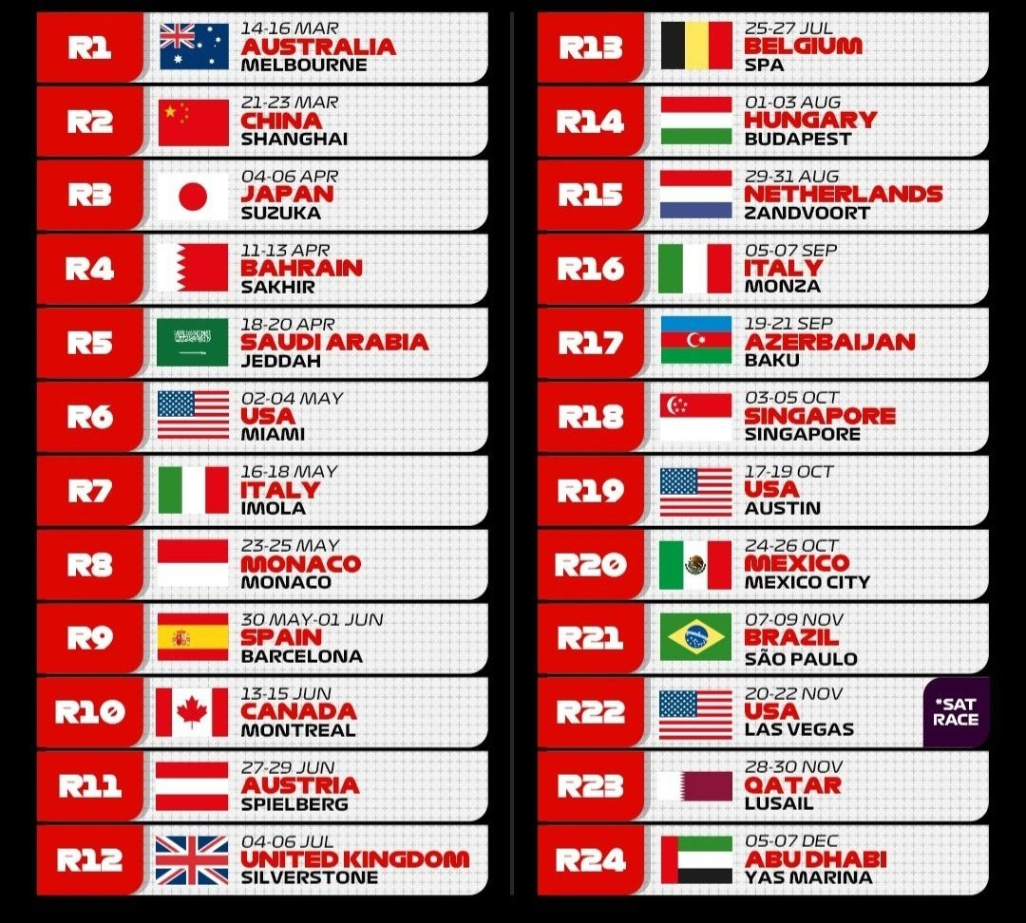
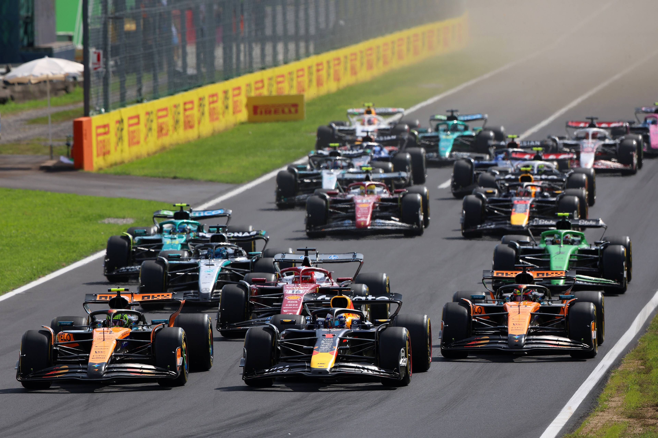
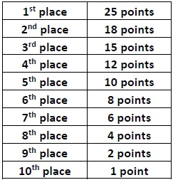
What is f1?

Slide 3
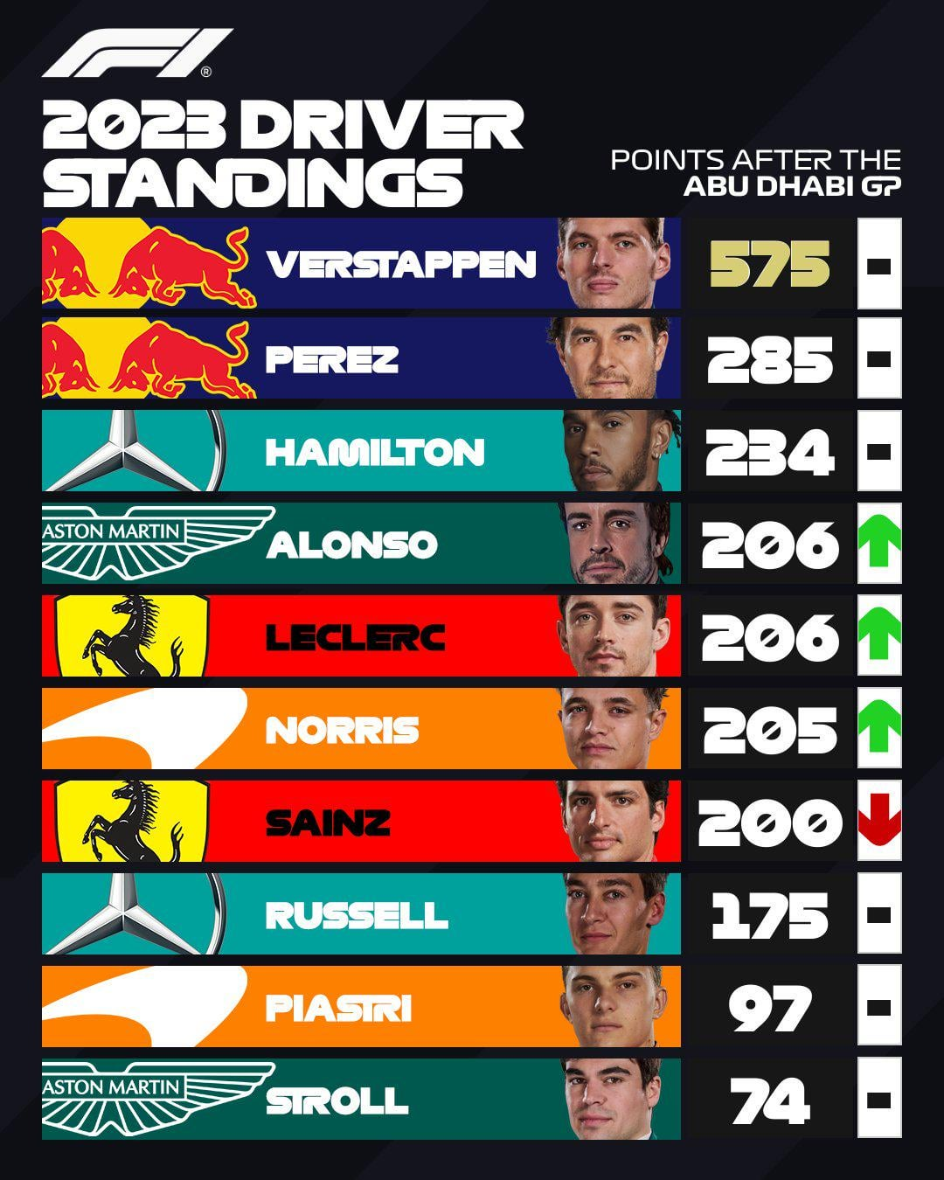
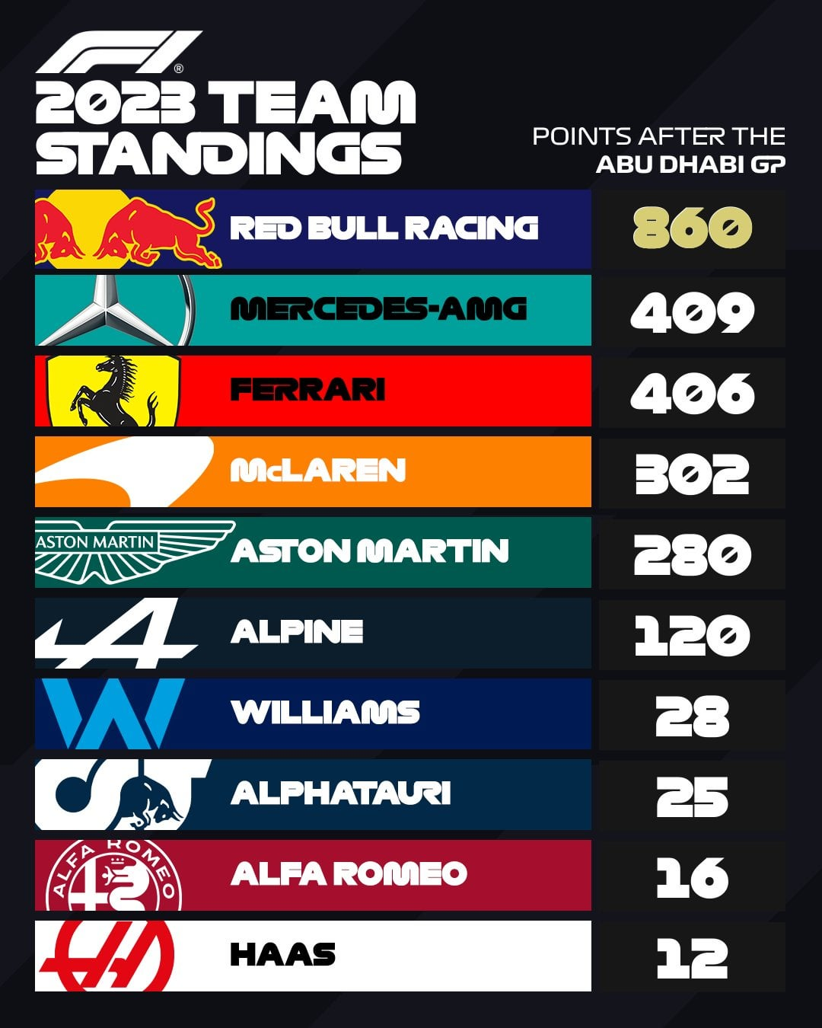

Slide 4
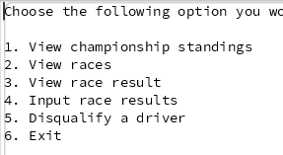
Introduction
Simulation of a formula 1 championship database
Uses 24 races, sprint races excluded
Allows user to input results, view races, standings, race results
Automatically calculates standings
Designed for a race Stewart (or anyone that manages results)

Slide 5
Entities & Relationships
Entities:
Teams
Drivers
Races
Relationships:
RaceResults

Slide 6
DDL statements for entity tables
CREATE TABLE races (
race_id INTEGER PRIMARY KEY,
race_name TEXT NOT NULL,
track_name TEXT NOT NULL,
location TEXT NOT NULL );
CREATE TABLE teams (
team_id INTEGER PRIMARY KEY,
name TEXT,
country TEXT,
points INTEGER );
CREATE TABLE drivers (
driver_id INTEGER PRIMARY KEY,
name TEXT NOT NULL,
nationality TEXT,
number INTEGER UNIQUE,
points INTEGER,
team_id INTEGER,
FOREIGN KEY (team_id) REFERENCES teams(team_id) );

Slide 7
DDL statements for relationship tables
CCREATE TABLE raceResults (
result_id INTEGER PRIMARY KEY,
race_id INTEGER NOT NULL,
driver_id INTEGER NOT NULL,
position INTEGER,
points_earned INTEGER,
FOREIGN KEY (race_id) REFERENCES races(race_id),
FOREIGN KEY (driver_id) REFERENCES drivers(driver_id),
UNIQUE (race_id, driver_id),
UNIQUE (race_id, position) );

Slide 8
Sample Insert Statements
INSERT INTO teams VALUES (1, 'Ferrari', 'Italy', 0);
INSERT INTO teams VALUES (2, 'McLaren', 'UK', 0);
INSERT INTO drivers VALUES (1, 'Lewis Hamilton', 'UK', 44, 0, 1);
INSERT INTO drivers VALUES (2, 'Charles Leclerc', 'Monaco', 16, 0, 1);
INSERT INTO races VALUES (1, 'Australian Grand Prix', 'Albert Park Circuit', 'Melbourne, Australia');
INSERT INTO raceResults VALUES (1, 1, 7, 1, 25);

Slide 9
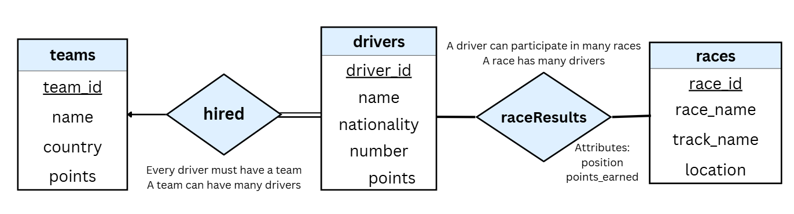
ER DIAGRAM

Slide 10
SQL Operations Used
CREATE → tables
INSERT → teams, drivers, races
SELECT → standings, race results
UPDATE → driver and team points
DELETE → disqualification

Slide 11
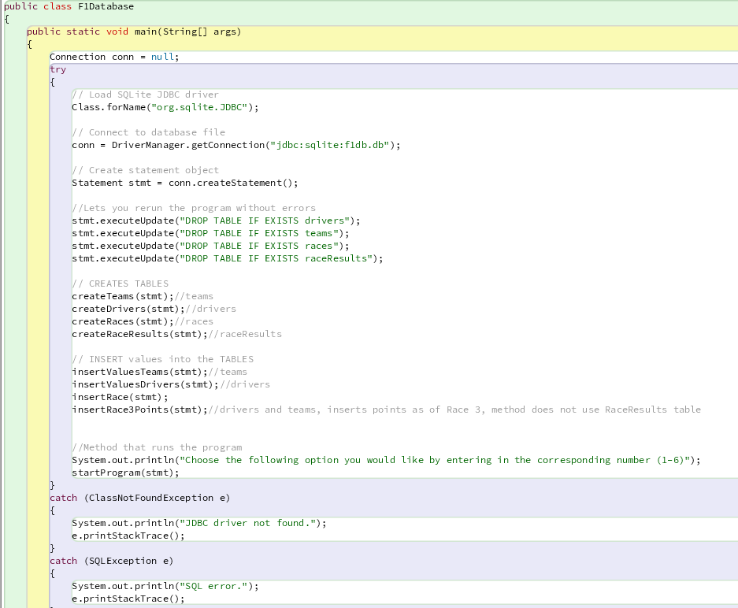
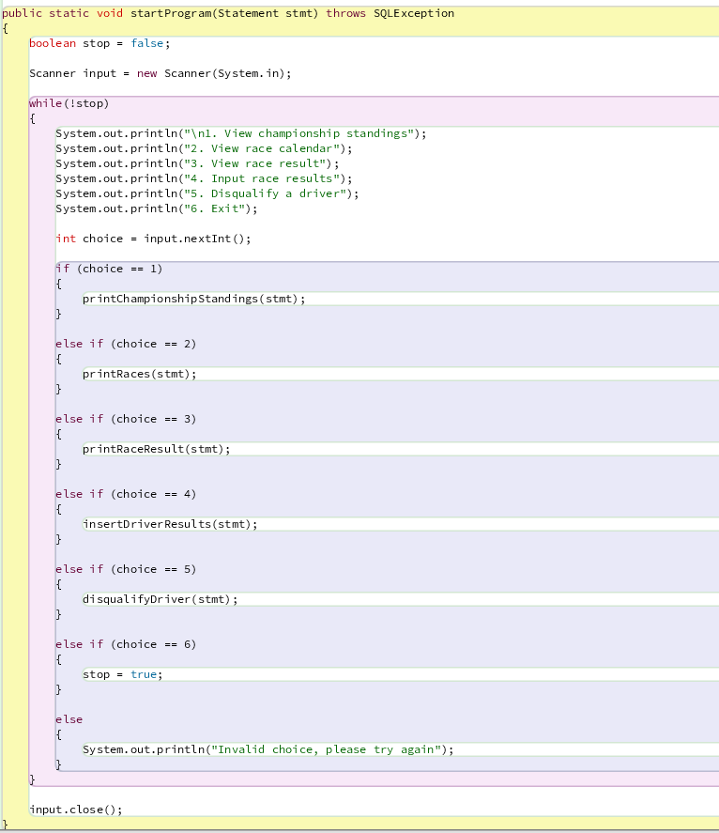

Slide 12
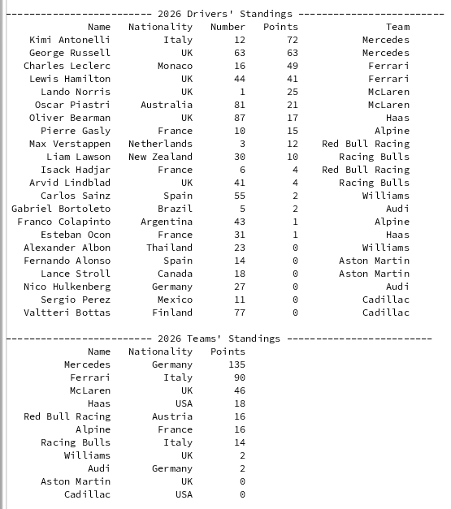
View Championship Standings
Used current championship standings as of race 3

Slide 13
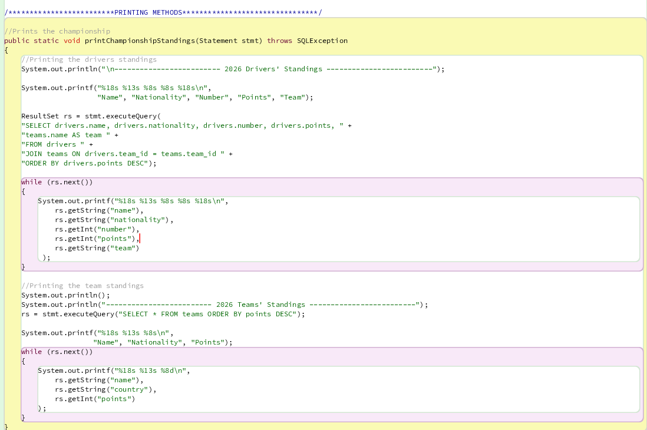

Slide 14
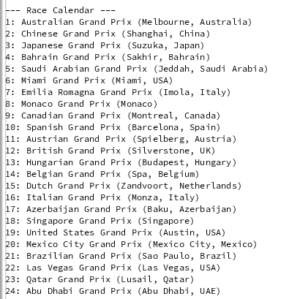
2. View race calendar
Shows all the races
In order

Slide 15
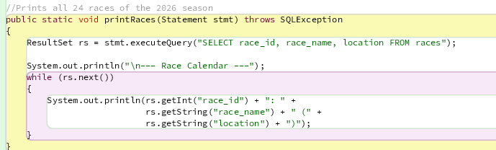

Slide 16

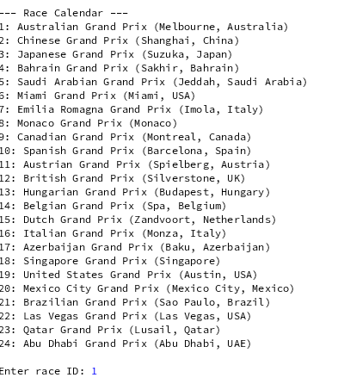
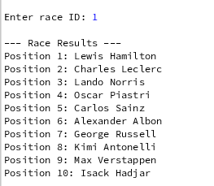
3. View Race Results

Slide 17
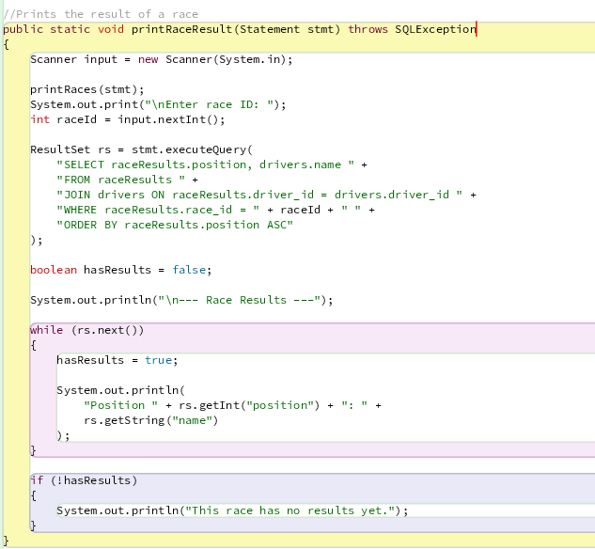

Slide 18
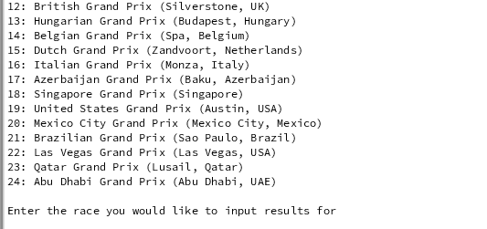
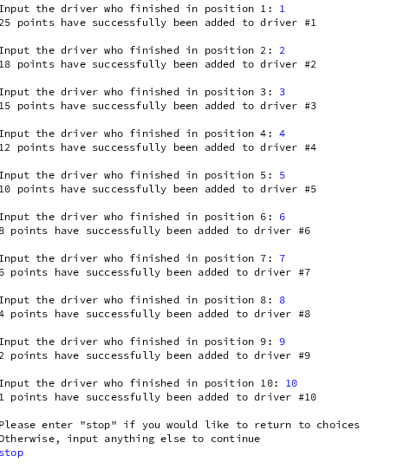
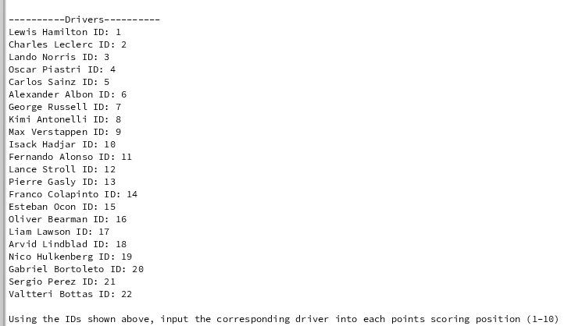
4. Input Race Results

Slide 19
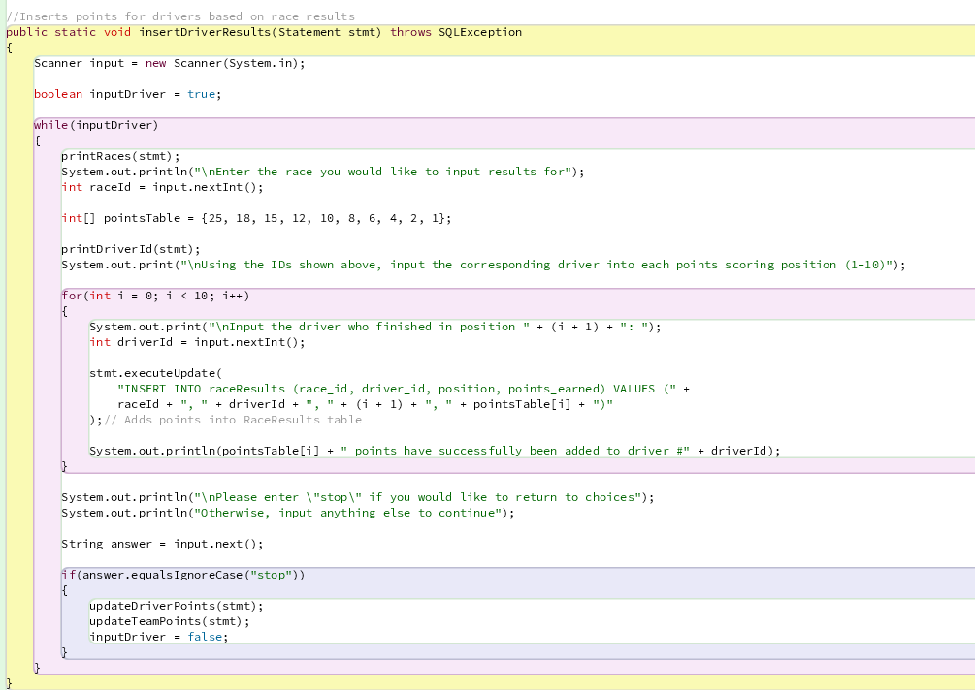

Slide 20
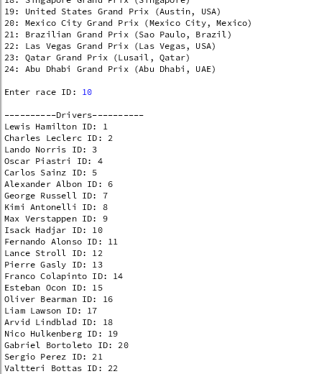

5. Disqualify a driver
Prompts for race
Prompts for driver to disqualify

Slide 21
